Slide 1
Heaps & Heap Sort
Priority Queues

Slide 2
Priority Queues
A queue that is ordered according to some priority value
Standard Queue Priority Queue
enqueue dequeue enqueue dequeue
Add at Remove Add Remove
end from front according from front
to priority
value
Q
Q

Slide 3
Applications of Priority Queues
Line-up of Incoming Planes at Airport
  Possible Criteria for Priority?
Operating Systems Priority Queues?
  Several criteria could be mapped to a priority status

Slide 4
Max-Priority Queue Operations
Insert( S, x ) – Inserts element x into set S, according to its priority
Maximum( S ) – Returns, but does not remove, the element of S with the largest key
Extract-Max( S ) – Removes and returns the element of S with the largest key
Increase-Key( S, x, k ) – Increases the value of element x’s keyto the new value k

Slide 5
Possible Implementations?

Slide 6
Max-Priority Queue Operations
?

Slide 7
Binary Heaps
The (binary) heap data structure is an array object that can be viewed as a complete binary tree
  Each node of the tree corresponds to an element of the array that stores the value in the node.
  The tree is completely filled on all levels except possibly the lowest, where it is filled from the left up to a point.
A =
16
14
10
8
7
9
3
2
4
1
16
14
10
8
7
9
3
2
4
1

Slide 8
Binary Heaps
To represent a complete binary tree as an array:
  The root node is A[1]
  Node i is A[i]
  The parent of node i is A[i/2]
  The left child of node i is A[2i]
  The right child of node i is A[2i + 1]
Parent(i)
return floor(i/2)
Right(i)
return 2i+1
Left(i)
return 2i
16
A =
16
14
10
8
7
9
3
2
4
1
14
10
8
7
9
3
2
4
1

Slide 9
Types of Binary Heaps
Min-Heaps:
  The element in the root is less than or equal to all elements in both of its sub-trees
  Both of its sub-trees are Min-Heaps
Max-Heaps:
  The element in the root is greater than or equal to all elements in both its sub-trees
  Both of its sub-trees are Max-Heaps
16
14
10
8
7
9
3
2
4
1

Slide 10
The Heap Property
Max-Heaps satisfy the heap property:
A[Parent(i)] ≥ A[i] for all nodes i > 1
  In other words, the value of a node is at most the value of its parent
  The largest element in a max-heap is stored at the root
Min-Heaps satisfy the heap property:
A[Parent(i)] ≤ A[i] for all nodes i > 1
  In other words, the value of a node is at least the value of its parent
  The smallest element in a min-heap is stored at the root

Slide 11
Max-Heap Operations: Max-Heapify()
Max-Heapify(): maintain the max-heap property
  Given: a node i in the heap with children l and r
  Given: two subtrees rooted at l and r, assumed to be heaps
  Problem: The subtree rooted at i may violate the heap property (How?)
  Action: let the value of the parent node “float down” so subtree at i satisfies the heap property
    What do you suppose will be the basic operation between i, l, and r?

Slide 12
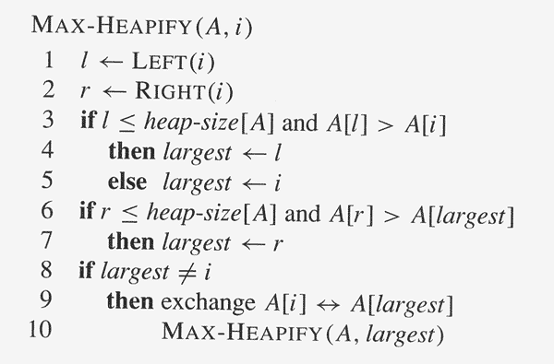
Max-Heap Operations: Max-Heapify()
Assumed that the binary trees
rooted at LEFT(i ) and RIGHT(i )
are already max-heaps.

Slide 13
Heapify() Example
16
4
10
14
7
9
3
2
8
1
A =
16
4
10
14
7
9
3
2
8
1

Slide 14
Heapify() Example
16
4
10
14
7
9
3
2
8
1
A =
16
4
10
14
7
9
3
2
8
1

Slide 15
Heapify() Example
16
4
10
14
7
9
3
2
8
1
A =
16
4
10
14
7
9
3
2
8
1

Slide 16
Heapify() Example
16
14
10
4
7
9
3
2
8
1
A =
16
14
10
4
7
9
3
2
8
1

Slide 17
Heapify() Example
16
14
10
4
7
9
3
2
8
1
A =
16
14
10
4
7
9
3
2
8
1

Slide 18
Heapify() Example
16
14
10
4
7
9
3
2
8
1
A =
16
14
10
4
7
9
3
2
8
1

Slide 19
Heapify() Example
16
14
10
8
7
9
3
2
4
1
A =
16
14
10
8
7
9
3
2
4
1

Slide 20
Heapify() Example
16
14
10
8
7
9
3
2
4
1
A =
16
14
10
8
7
9
3
2
4
1

Slide 21
Heapify() Example
16
14
10
8
7
9
3
2
4
1
A =
16
14
10
8
7
9
3
2
4
1

Slide 22
Analyzing Heapify(): Informal
Aside from the recursive call, what is the running time of Heapify()?
How many times can Heapify() recursively call itself?
What is the worst-case running time of Heapify() on a heap of size n?

Slide 23
Analyzing Heapify(): Formal
Fixing up relationships among the elements A[i], A[l], and A[r] takes Θ(1) time
If the heap at i has n elements, at most how many elements can the subtrees at l or r have?
Answer: 2n/3 (worst case: bottom row half full)
So time taken by Heapify() is given by
T(n) ≤ T(2n/3) + Θ(1)
i
16
l
r
14
10
8
7
9
3
2
4
1
5

Slide 24
Analyzing Heapify(): Formal
So we have
T(n) ≤ T(2n/3) + Θ(1)
Solving the recurrence, we have
T(n) = O(lg n)
Thus, Heapify() takes O(h) time for a node at height h.

Slide 25
Heap Operations: BuildHeap()
We can build a heap in a bottom-up manner by running Heapify() on successive subarrays
  Fact: for array of length n, all elements in the range
  A[⎣n/2⎦ + 1 ... n] are heaps (Why?)
  So:
    Walk backwards through the array from n/2 to 1, calling Heapify() on each node.
    Order of processing guarantees that the children of node i are heaps when i is processed

Slide 26
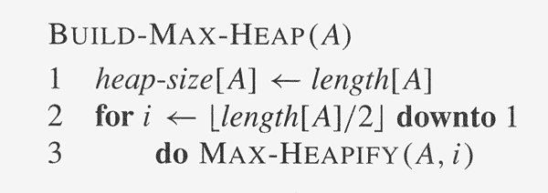
Heap Operations: BuildHeap()
Converts an unorganized array A into a max-heap.

Slide 27
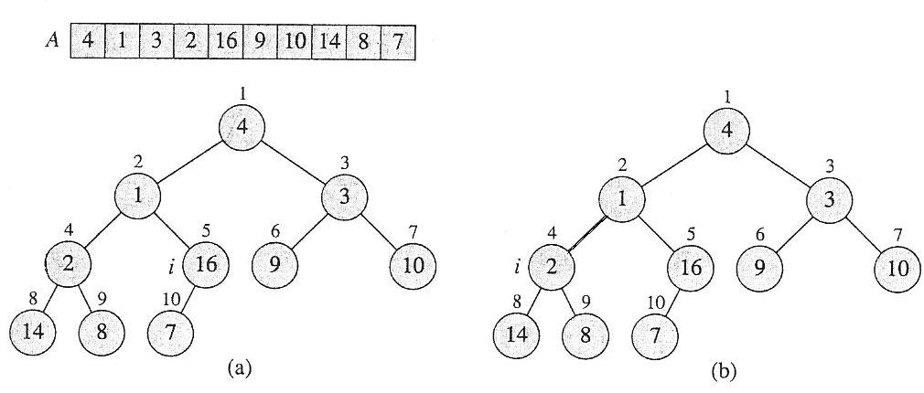
BuildHeap() Example
Work through example
A = {4, 1, 3, 2, 16, 9, 10, 14, 8, 7}

Slide 28
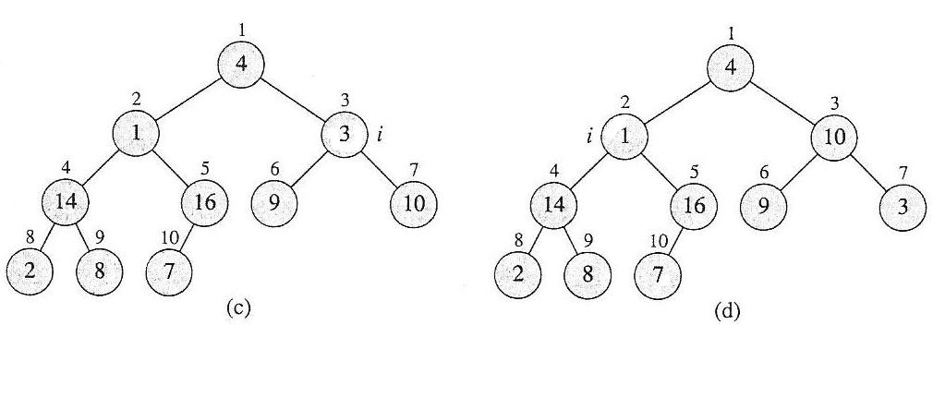
BuildHeap() Example

Slide 29
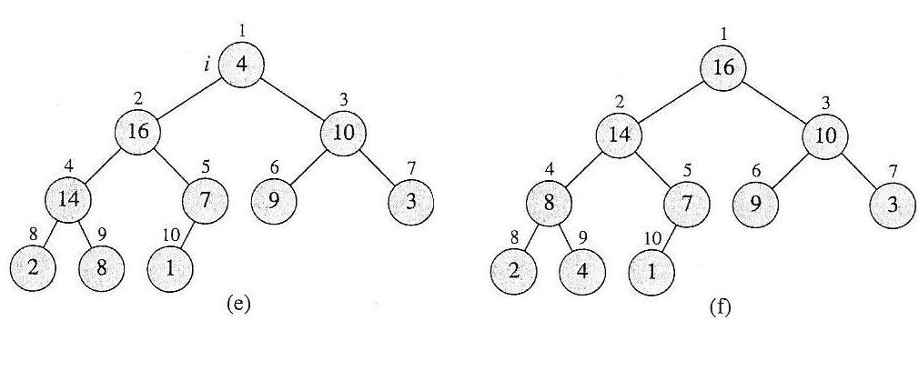
BuildHeap() Example

Slide 30
Analyzing BuildHeap()
Each call to Heapify() takes O(lg n) time
There are O(n) such calls (specifically, ⎣n/2⎦)
Thus the running time is O(n lg n)
  Is this a correct asymptotic upper bound?
  Is this an asymptotically tight bound?
A tighter bound is O(n)
  How can this be? Is there a flaw in the above reasoning?

Slide 31
Analyzing BuildHeap(): Tight
To Heapify() a subtree takes O(h) time, where h is the height of the subtree
  h = O(lg m), m = # nodes in the subtree
  The height of most subtrees is small
Fact: an n-element heap has at most ⎡n/2^{h+1}⎤ nodes of height h
Prove that BuildHeap() takes O(n) time

Slide 32
Heapsort
Given BuildHeap(), a sorting algorithm can easily be constructed:
  Maximum element is at A[1]
  Discard by swapping with element at A[n]
    Decrement heap_size[A]
    A[n] now contains correct value
  Restore heap property at A[1] by calling Heapify()
  Repeat, always swapping A[1] for A[heap_size(A)]

Slide 33
Heapsort
Heapsort(A)
{
BuildHeap(A);
for (i = length(A) downto 2)
{
Swap(A[1], A[i]);
heap_size(A) = heap_size(A) − 1;
Heapify(A, 1);
}
}

Slide 34
Analyzing Heapsort
The call to BuildHeap() takes O(n) time
Each of the n - 1 calls to Heapify() takes O(lg n) time
Thus the total time taken by HeapSort()
= O(n) + (n - 1) O(lg n)
= O(n) + O(n lg n)
= O(n lg n)

Slide 35
Priority Queues
Heapsort is a nice algorithm, but in practice Quicksort (coming up) usually wins
The heap data structure is incredibly useful for implementing priority queues
  A data structure for maintaining a set S of elements, each with an associated value or key
  Supports the operations Insert(), Maximum(), and ExtractMax()

Slide 36
Priority Queue Operations
Insert( S, x ) – Inserts element x into set S, according to its priority
Maximum( S ) – Returns, but does not remove, the element of S with the largest key
Extract-Max( S ) – Removes and returns the element of S with the largest key
Increase-Key( S, x, k ) – Increases the value of element x’s key to the new value k
How could we implement these operations using a heap?

Slide 37
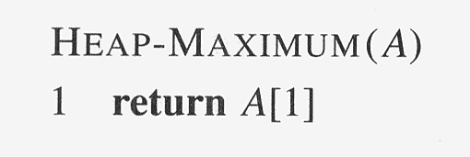
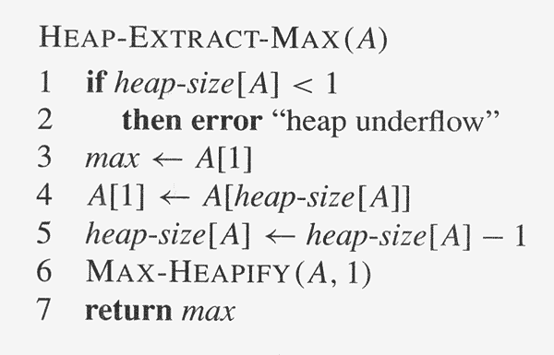
Priority Queue Operations

Slide 38
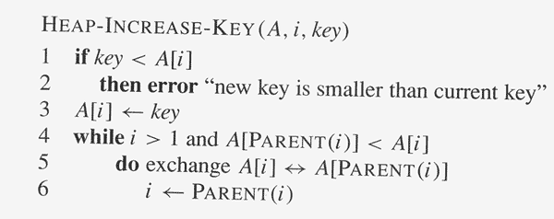
Priority Queue Operations

Slide 39
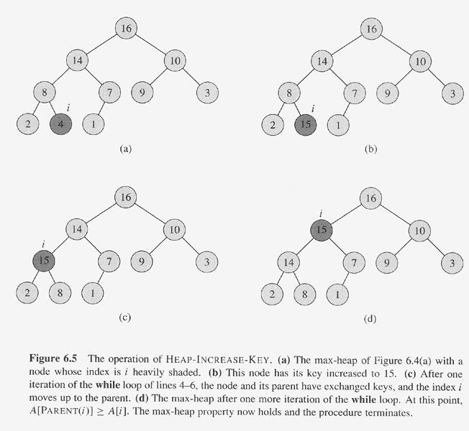
Priority Queue Operations

Slide 40
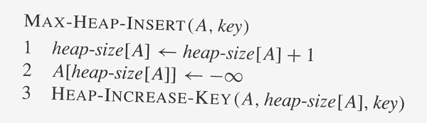
Priority Queue Operations

